Slide 1
EXPLORE THE WORLD
Presented By Team - 10:
Aravind Sheri
Sharath Koppu
V Bhanu Sudheer
Aditya Somam

Slide 2
Motivation and Significance
Traveling the world or visiting an unknown place is always exiting and very refreshing.
There is no one global language to communicate and there exists number of local languages and communication is the primary problem and traveling makes life difficult.
Our Application provides a medium to communicate in any language and various other functionalities to make a tourist’s life easy.
Our Application will reduce the various barriers of a tourist to travel around the world and it will run on any platform to make life easy.

Slide 3
Application Features
Application has the main feature as language translation that is either text from user language to text of local language of various regions.
User can register or sign in using username and password which are stored in firebase storage.
User can register using login page where user should provide username and password and the user details will be stored in firebase.
The main feature of our application is to translate the text that is entered by the tourist in the native language and translate the text entered to local language where tourist visited so that communication will not be a barrier.
Tourist using the application can locate his position using the maps in the application and use to navigate to various positions.
Another important feature of the application is to extract the data from an image so that tourist can take a photo of a text using his phone and provide the photo as input and extract the data that is editable.
Another cool feature in the application is image analysis which is very much useful in understanding various traffic signals in various remote areas that are pretty much different and get insights from various images.
To overcome the barrier of communicating with the local people where they cannot read we added a feature to convert the translated text into voice so that it is easy and understandable to the local people.

Slide 4
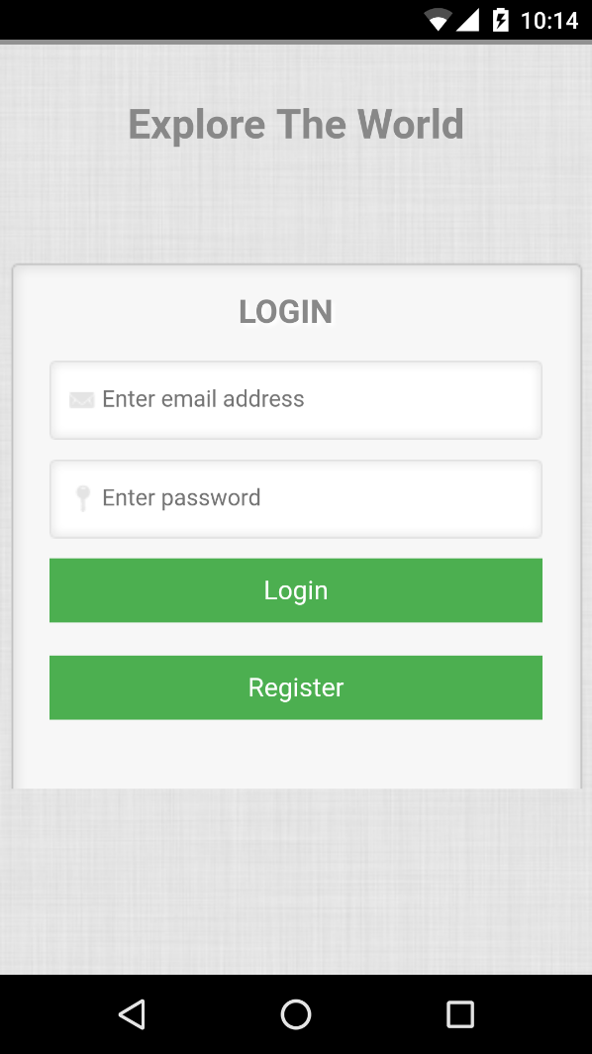
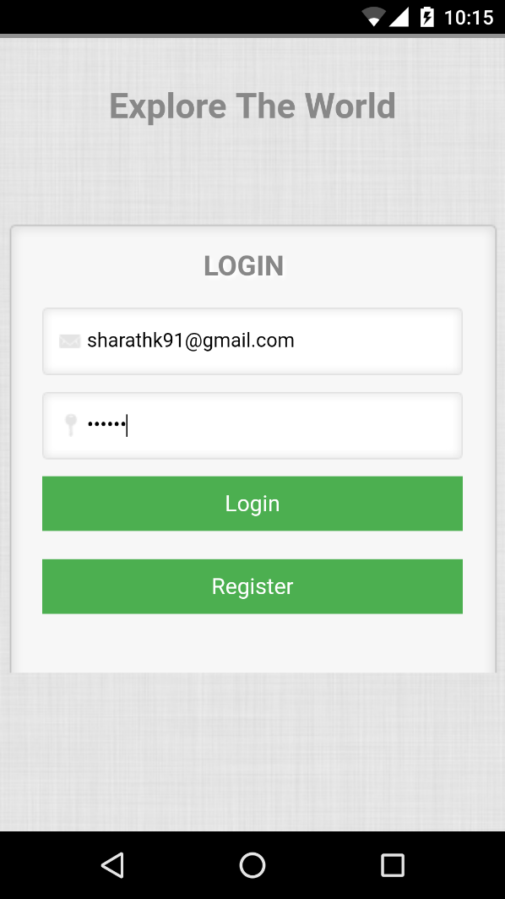
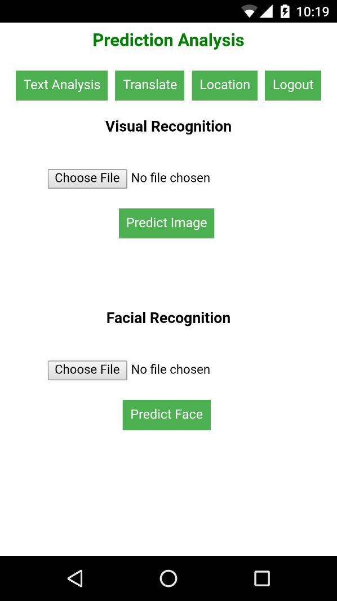
Overview of the Application
Home Page of the application after login using username and password used while signup.

Slide 5
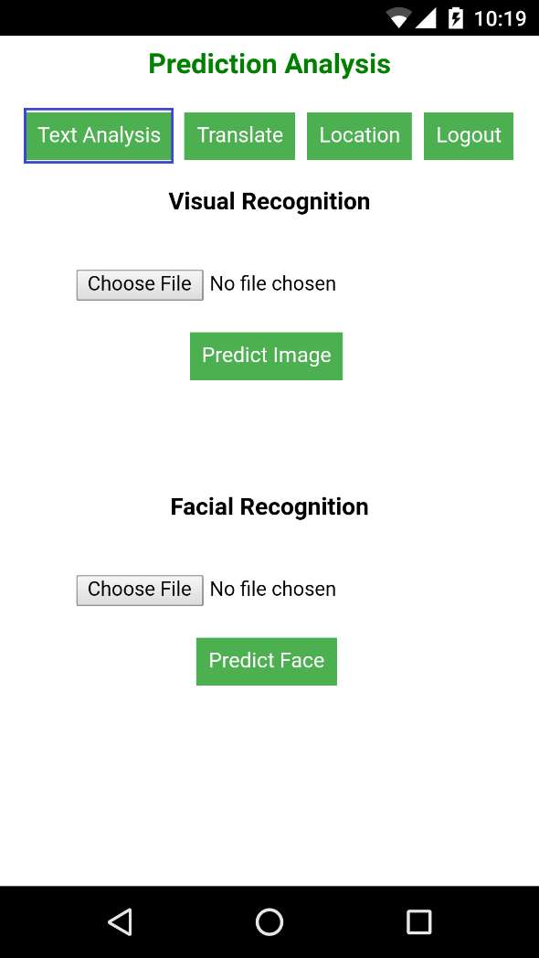
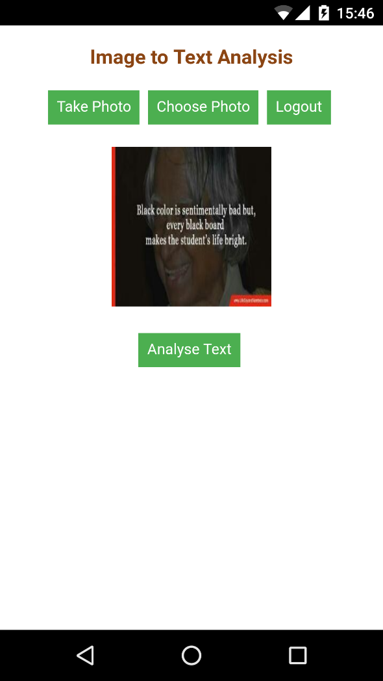
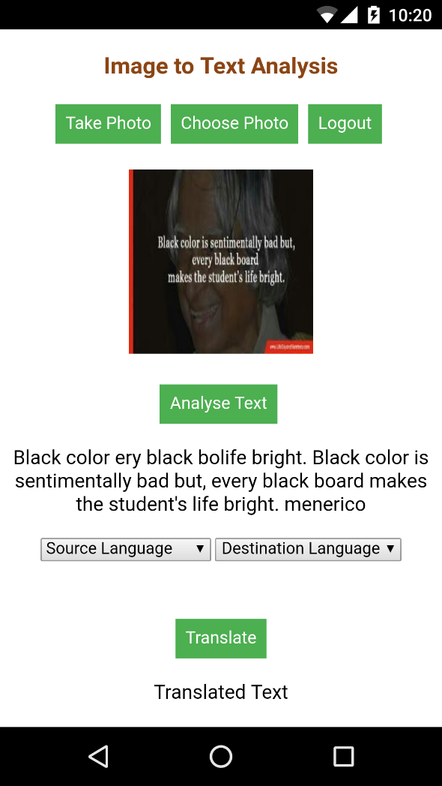
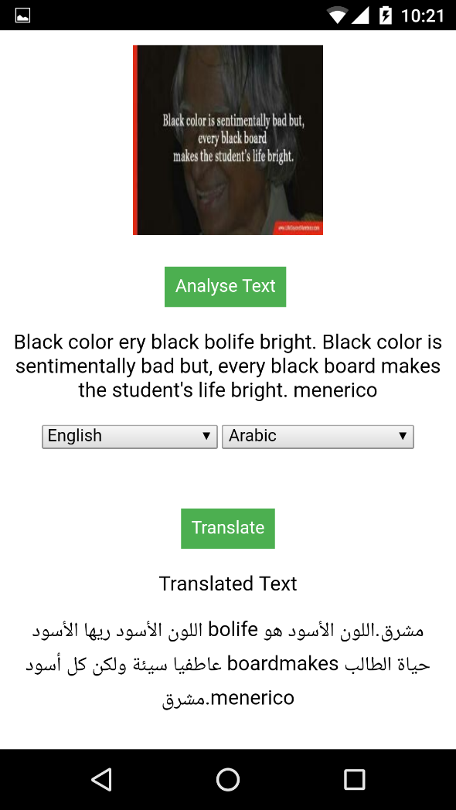
Capturing Data from an Image
Extracts the data from an image so that it is further used to translate into the language which tourist wanted to.

Slide 6
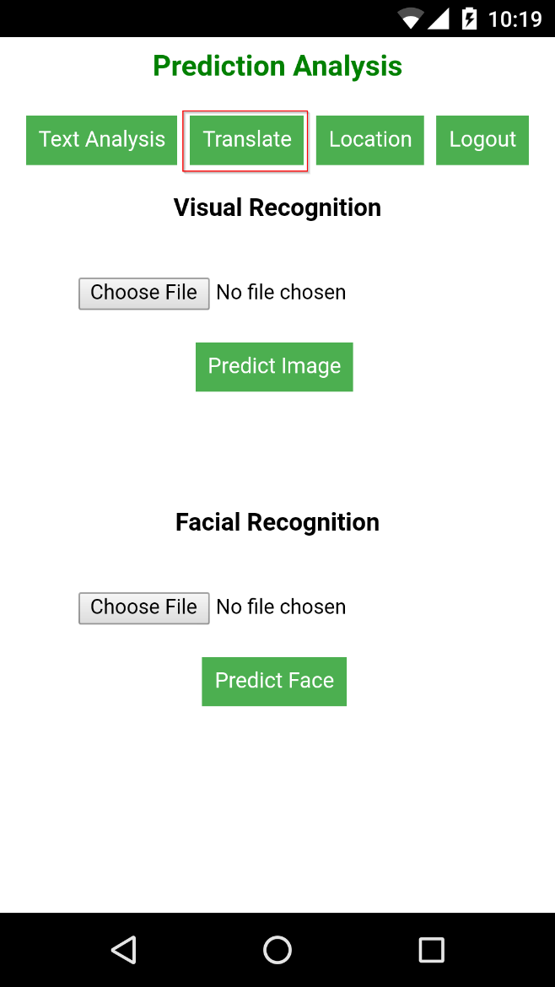
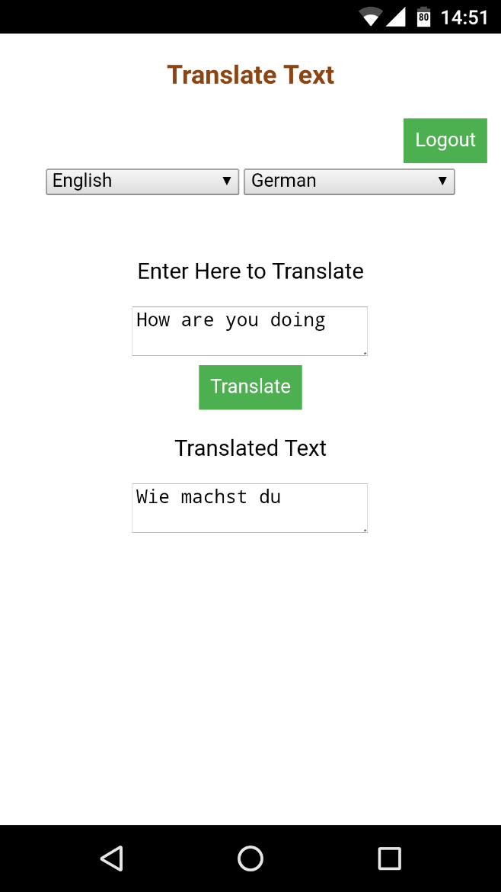
Translation of Text
Tourist selects the languages from which he wants to translate to and translate from. The text he entered will be translated to destination language which is selected.

Slide 7
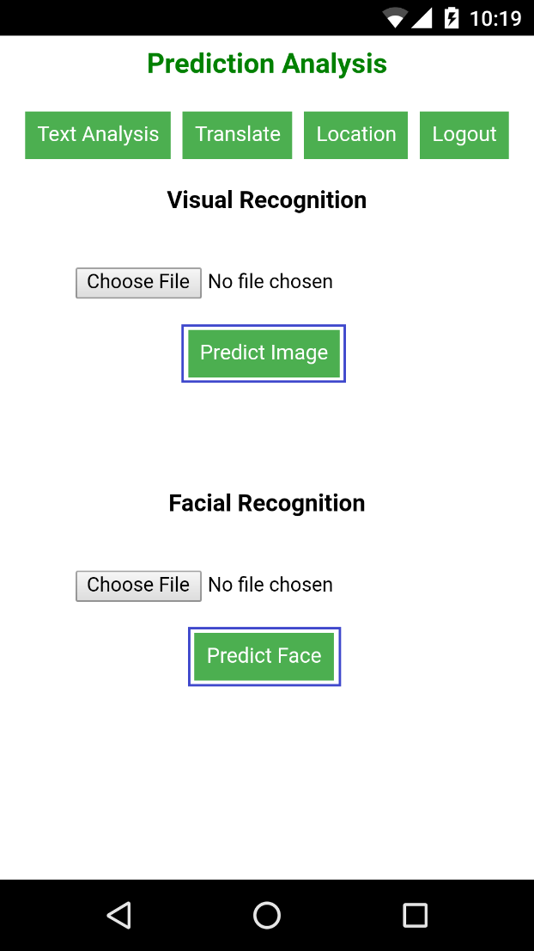
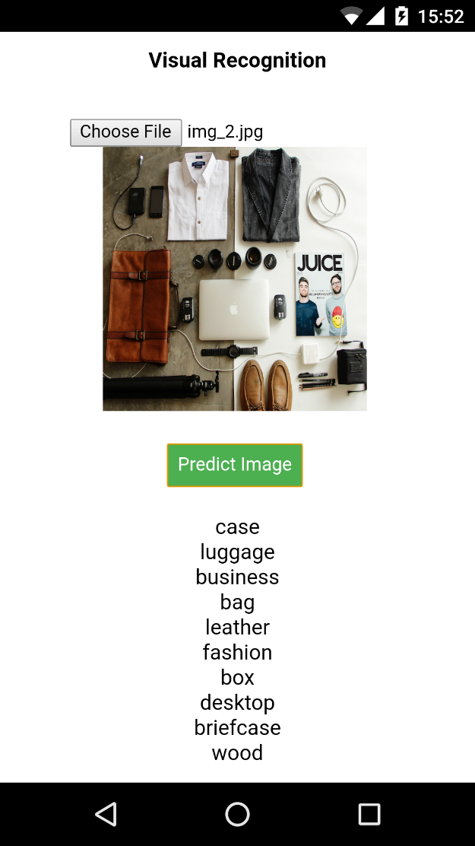
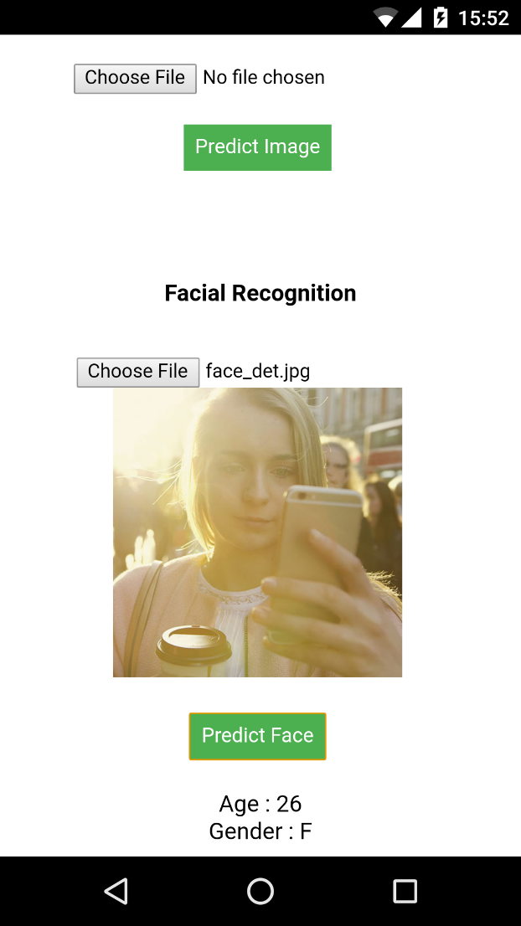
Facial and Visual Detection
Different symbols and facial detection is included in the application to help the tourist who come across different symbols like during a road travel etc..

Slide 8
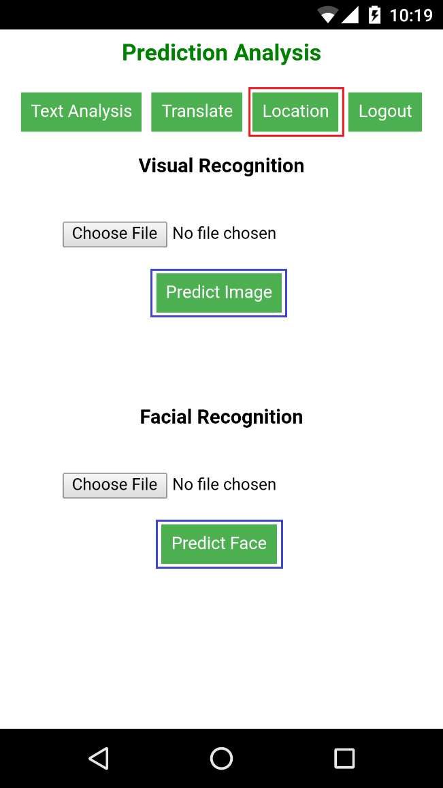
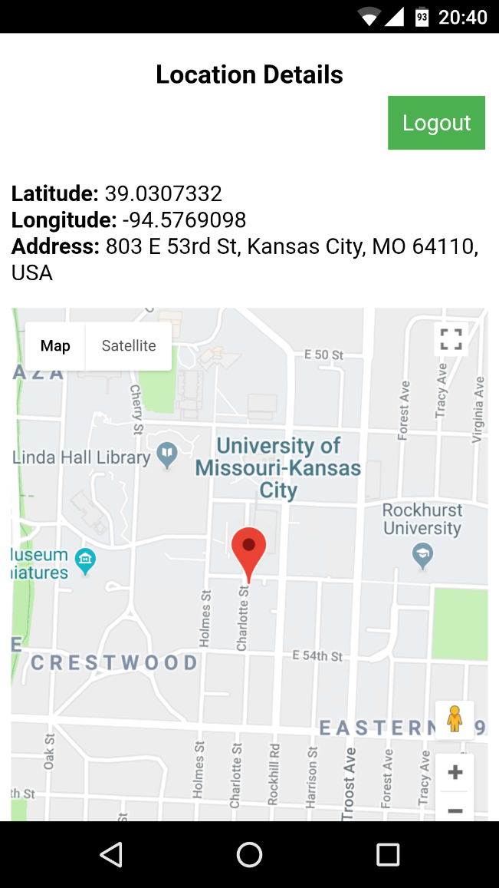
Location Detection
We have integrated Google maps into the application where tourist can get the current location and address.

Slide 9
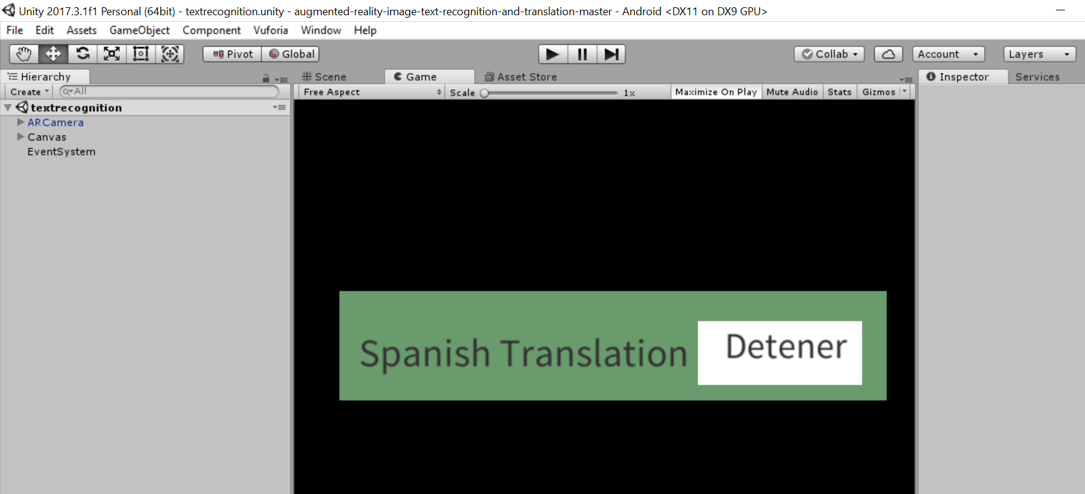
Augmented Reality

Slide 10
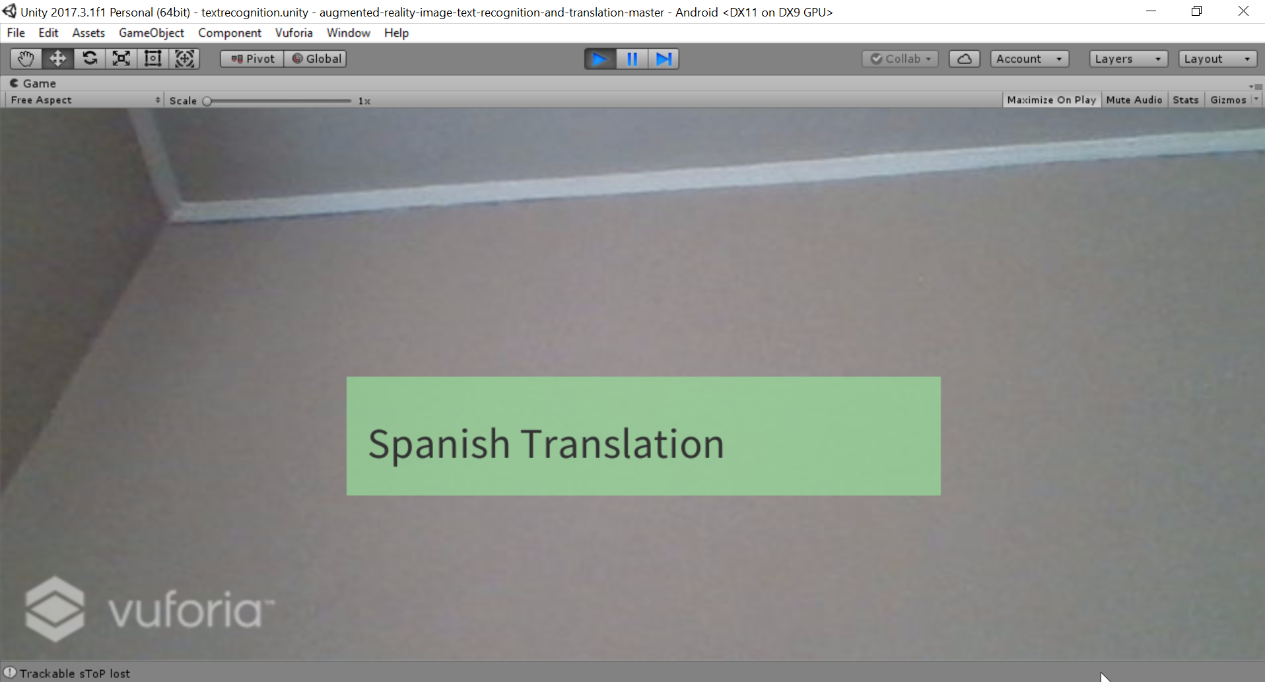

Slide 11
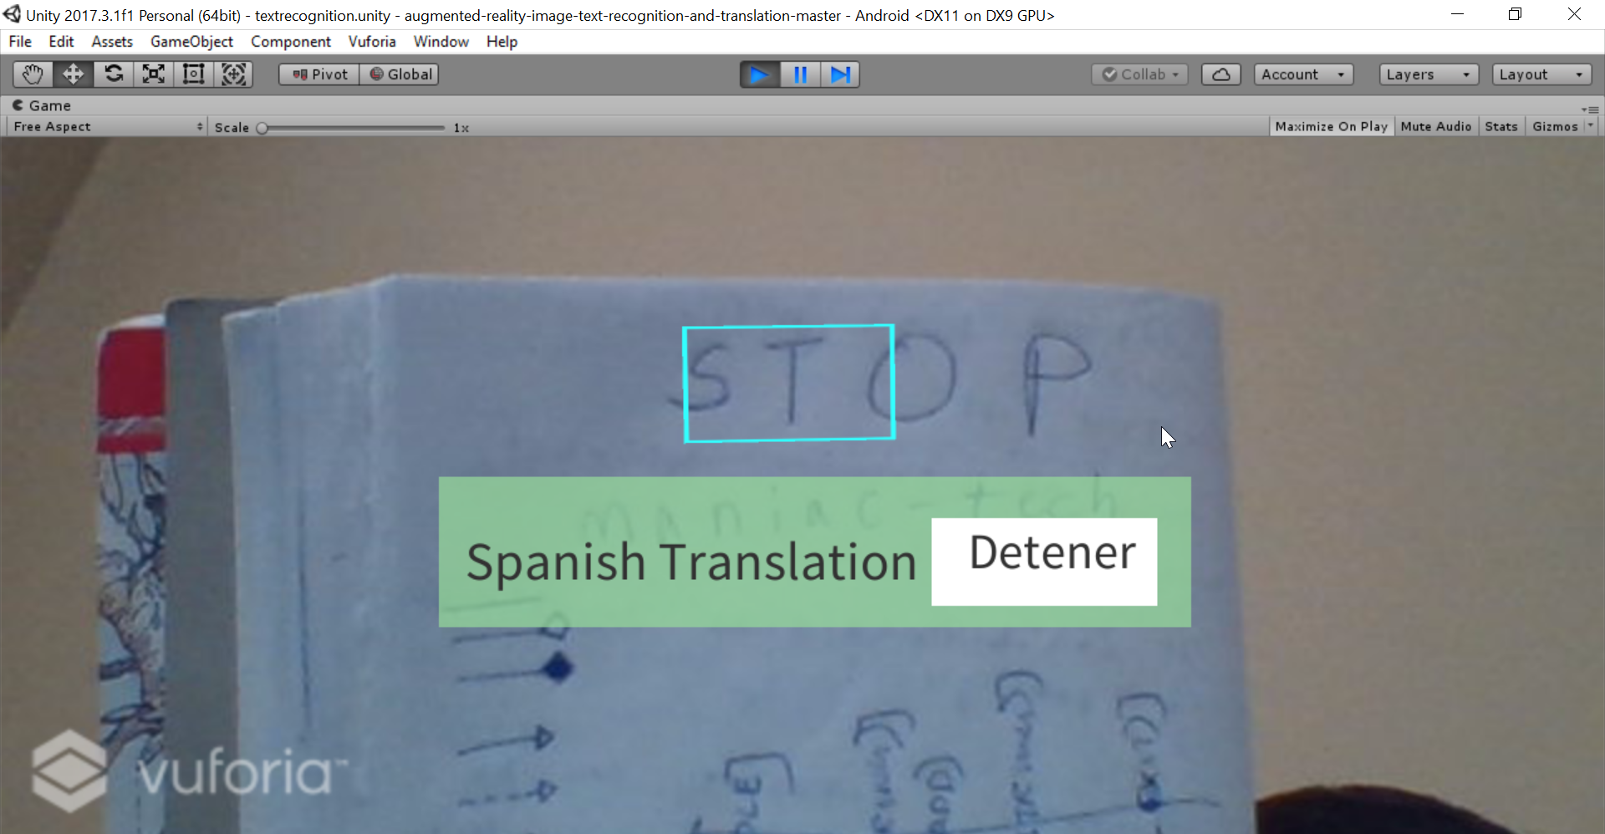

Slide 12
Thank You!!!

